Slide 1


Basics of C programming language
2nd April,2015
Soumyadeep Roy
2nd year, CSE
Kalyani Government Engineering College

Slide 2

Inbuilt C libraries
Keep in mind.
Library_name Commonly needed methods
stdio.h - printf , scanf
stdlib.h - free , malloc
string.h - strlen , strcmp , strcpy , strncpy
To use any method of a library, you need to mention the name of the library at the top of your program :
Syntax: #include<library_name.h>

Slide 3
printf
Function belongs to the in-built C library <stdio.h>
Syntax: #include<stdio.h>
Description: Display the formatted output generated by your program.
Declaration:
int printf( <format string>,<list of variables>)
Return value: If successful, the total number of characters written is returned. On failure, a negative number is returned..

Slide 4


Format String:
1. printf(“Programming is fun.”); Programming is fun.
2. printf(“Today is the %dth of April,%d”,date,year);
Today is the 2nd of April,2015 //date=2,year=2015 initialised
3.printf(“%d , %d”, 3+7,(date*year)); 10 , 4030
%d integer %f float %c character %s string %ld long integer
%lld long long integer

Slide 5
scanf
Function belongs to the in-built C library <stdio.h>
Syntax: #include<stdio.h>
Description: Reads formatted input from the user.
Declaration:
scanf( <format string>,<address of the variables>)
Return value: If successful, the total number of characters written is returned otherwise a negative number is returned.
scanf(“%d”,&num); //num is of integer type
& - ‘address of’ operator
&num - refers to the address of the variable ‘num’

Slide 6
scanf(“%c”,&ch);
Matches a fixed number of characters, always. You can specify the maximum number of characters to read; if you don't specify, the default is 1.
It also does not skip over initial whitespace characters.
  char str[30];
scanf(“%s”, str);
Matches a string of non-whitespace characters. It skips and discards initial whitespace, but stops when it encounters more whitespace after having read something.
Scanf continued …

Slide 7

Best Approach 1
When asked to take multiple strings as input each on
different lines.
char str[100];
scanf(“ %[^\n]s”,str);
Note the space before the % symbol is a must.
Usually, the ‘\n’ gets stored and is considered as another input. So, it eventually skips and causes the error in taking input.

Slide 8
Notes 1
\n Newline character - Prints output on the next line.
printf(“Yesterday was \nApril Fool’s Day”);
Yesterday was
April Fool’s Day
\t Tab character - Prints 4 or 8 spaces

Slide 9
break
Description: Transfers the control to the next statement outside the innermost loop.
int num;
while(1){
scanf(“%d”,&num);
if(num==42){
break; //Present control
}
printf(“%d”,num);
}
return 0; //Current control after reaching break statement

Slide 10
For loop
Description: Entry controlled loop. Used to repeat a set of statements until the desired condition is satisfied.
Syntax: for( initialisation ; condition ; updation){
statement 1;
.
}
statements;
Form 2 Nested :
Form1: for(i=0;i<row;i++){
for(i=0;i<row;i++){ for(j=0;j<colum;j++){
statement 1; statement 1; . .
} }
}

Slide 11
If-else if-else
Description: Entry controlled loop. Used to repeat a set of statements until the desired condition is satisfied.
Syntax: if(condition 1 is satisfied){
statement 1;
}
else if(condition 2 is satisfied){
statement 2;
}
else{
statement 3;
}

Slide 12
EOF - End Of File
Marks the end of the input file.
Remember: It does not mean the end of line which is denoted by the newline character ‘\n’
The value of EOF is -1.
scanf method returns an integer value
Code snippet:
int num;
while( scanf(“%d”,&num) != EOF ){ // iterates till the printf(“%d\n”, (num*num)); // end of input file
}

Slide 13
Problem 1
Take as input ‘n’ number of strings (each on a different
line) from the user and print the string on a new line.
Each string can have a maximum of 100 characters.
Solution:
int num,i; //num is the user input of the number of strings
scanf(“%d”,&num); //num is of integer type
char str[100]; // group of characters
for(i=0;i<num;i++){
scanf(“ %[^\n]s”,str);
printf(“%s”,str);
}

Slide 14
Best Approach 2
When you need to take large number of inputs using scanf
it takes a lot of extra time, which can be reduced.
Problem Name: Enormous Input/Output Test
Problem Code: INTEST
Time taken > 4.5 seconds (using C)
getchar_unlocked()

Slide 15
Best Approach 2 continued
    int dInput(){
    int t=0;
    scanf(“%d”,&num);
    char c;
    c=getchar_unlocked();
    while(c<'0' || c>'9')
    c=getchar_unlocked();
    int main(){
    while(c>='0' && c<='9'){ int num;
    t=(t<<3)+(t<<1)+c-'0'; num=dInput();
    c=getchar_unlocked(); printf(“%d”,num);
    } return 0;
    return t; }
    }

Slide 16
Best Approach 3
Homework 1: write the same for
char ch;
scanf(“%c”,&ch);
ch=cInput();
Homework 2: write the same for
char str[100];
scanf(“%s”,str);
sInput(str);

Slide 17
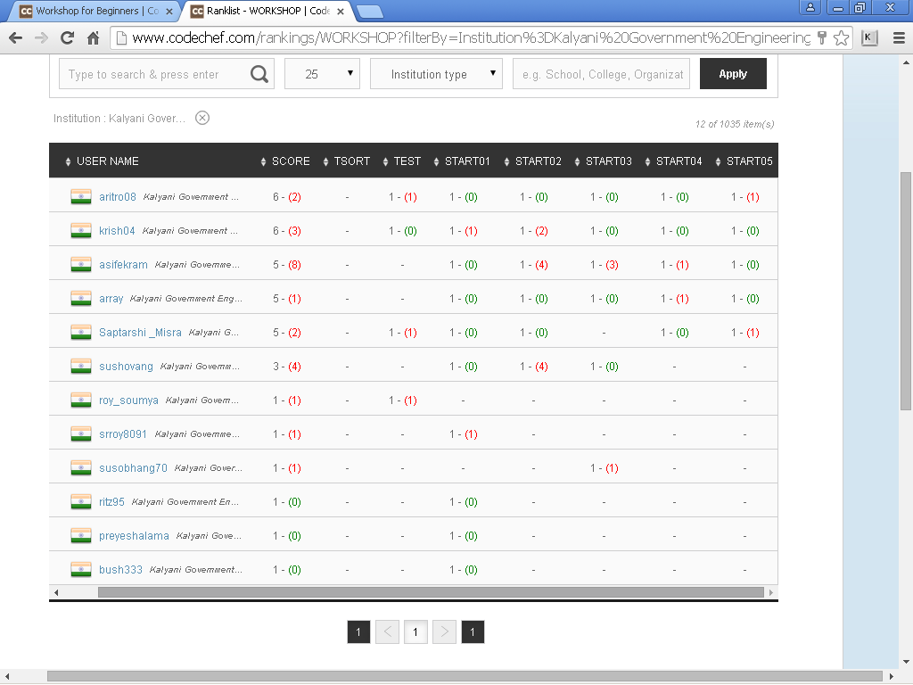
Current Workshop Rankings

